Slide 1
T02 nocLock
Travis, jaime, Sean, Cameron

Slide 2
Agenda
Project Motivation and Need
Design
Implementation
Testing
Results
Contributions and Lessons Learned
Q/A
Demo

Slide 3
Problem & Objective
Problem: Create an interesting alternative to traditional locking methods.
Objective: Work as a team to design, construct, and demonstrate a prototype that fulfills course requirements.

Slide 4
Possible Solution
RFID
Card Key
NES controller
Biometric Scanner

Slide 5
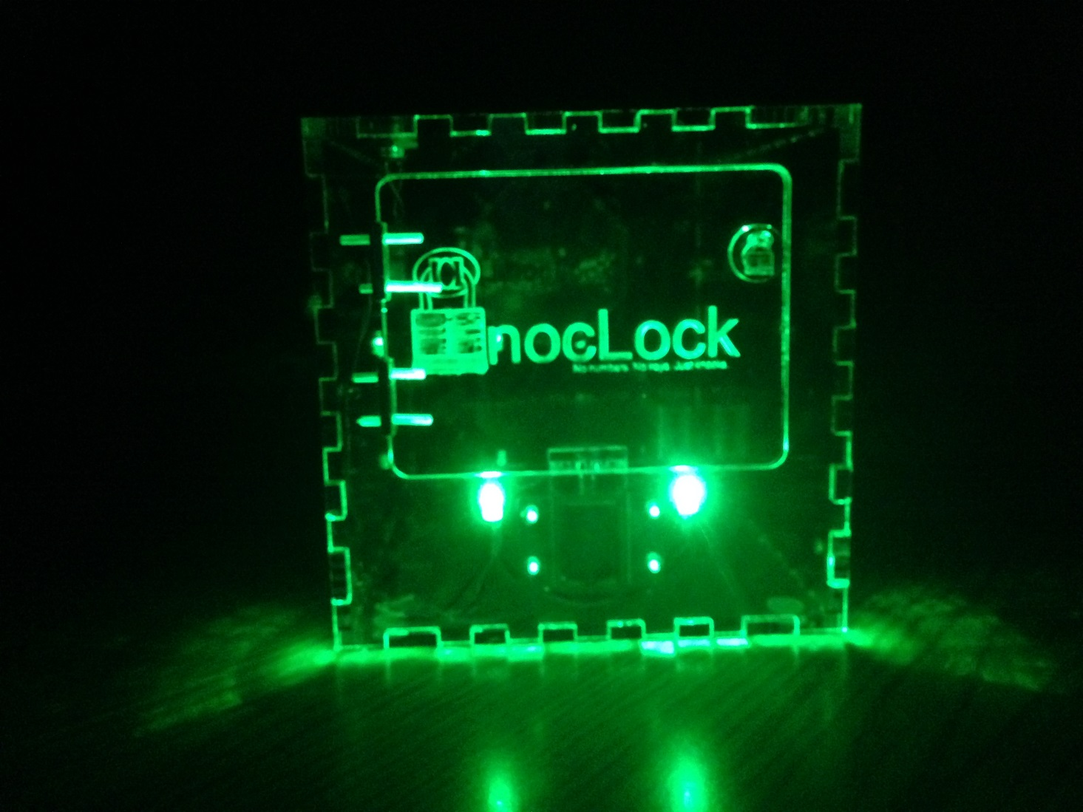
Our Solution

Slide 6
Requirements
Device must lock and unlock.
Device must differentiate between many distinct knock sequences.
Device must be reliable. (i.e. stay locked/unlocked when expected)
Device should be user friendly and intuitive.
Device must be safe to operate.
Device must be durable.

Slide 7
Approach/Overview of Project
Made decisions as a group
Multiple Decision Methods
Work was done by teams of two
Design
Verification
Consistent meeting times
Met every Friday

Slide 8
Inspiration & Research
Inspiration
Idea inspired by Adafruit ‘Secret Knock Detector’
Research
Bob Pease
Solenoid driver circuit
Various Youtube Videos
Working with AVR
Timers, ADC, Interrupts, etc.

Slide 9
System Design

Slide 10
Design Approach
Started with top down design
Block Diagram/Flow Chart
Modular design methodology
Concurrent Engineering

Slide 11
Hardware Level 0/Level 1

Slide 12
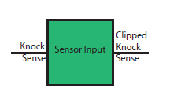
Sensor Input
Piezo element for knock
sensor.
Protects uC from >5v

Slide 13
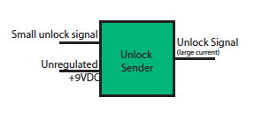
Unlock Module
Depends on lock
Deliver large current
to solenoid.
Various driver options
Relay
Darlington Pair
MOSFETs

Slide 14
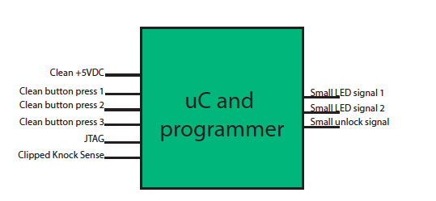
Microcontroller
Central Module
Various choices
Cost
Simplicity
Availability
Decided lowest cost as primary concern

Slide 15
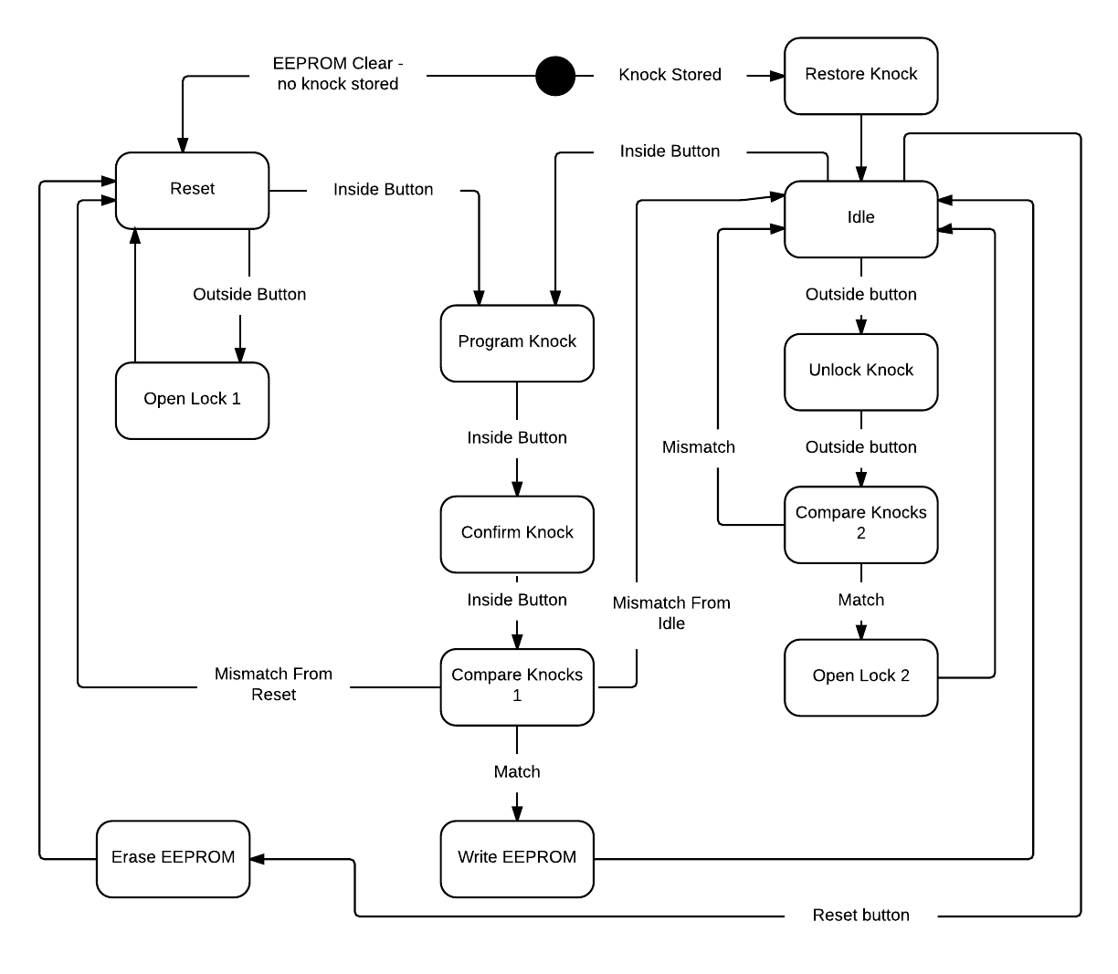
Software Flowchart

Slide 16
Software Algorithms
Knock Detection
ADC threshold
Knock Sensor Debounce
Timer starts after initial knock
Each Knock is stored at current time value
Knock combination is a collection of times
Knock Compare
Compare number of knocks
Compare timer values

Slide 17
Software Implemtation

Slide 18
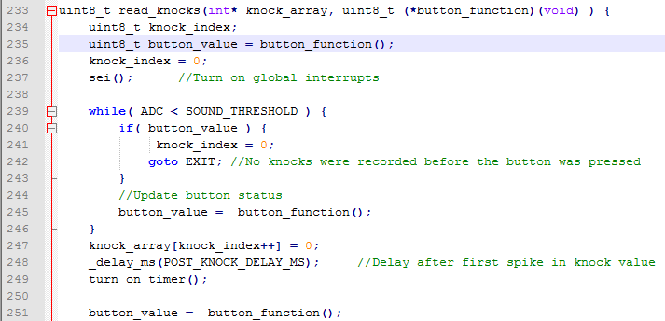
Read Knocks

Slide 19
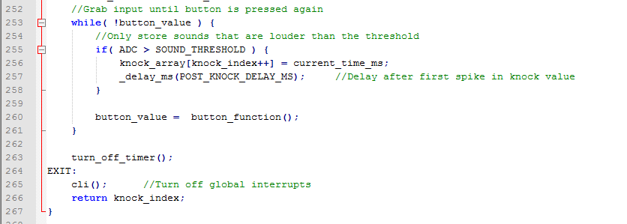
Read Knocks cont.

Slide 20
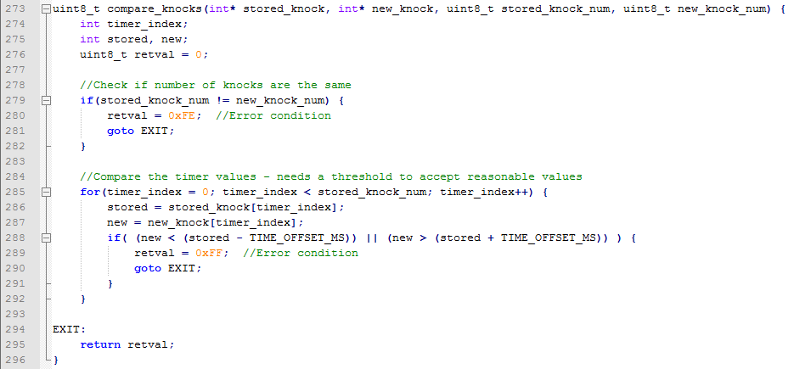
Compare Knocks

Slide 21
Hardware Implementation

Slide 22
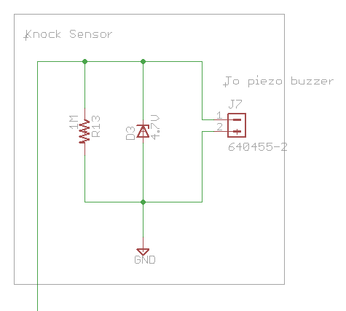
Knock Sense Subsystem
Protection diode clips voltage
Current drain
Connects via connector

Slide 23
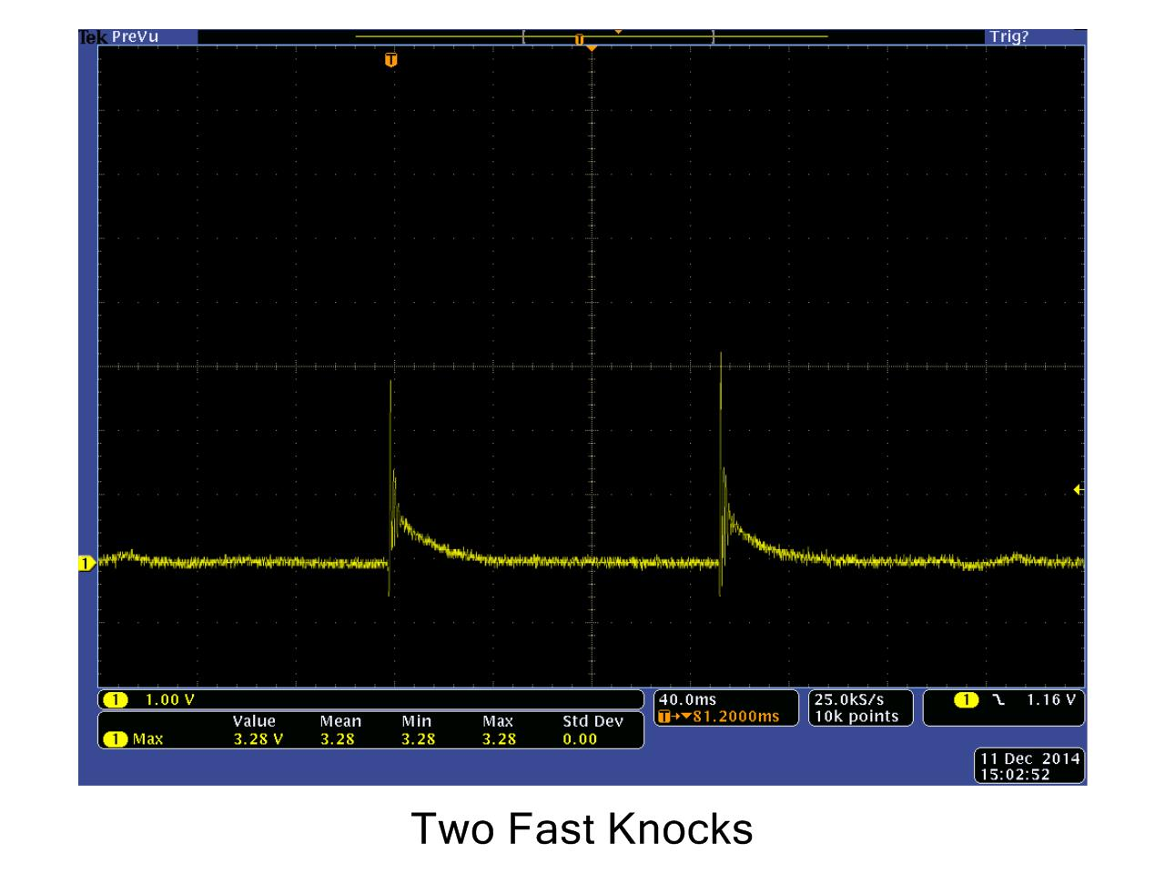

Slide 24
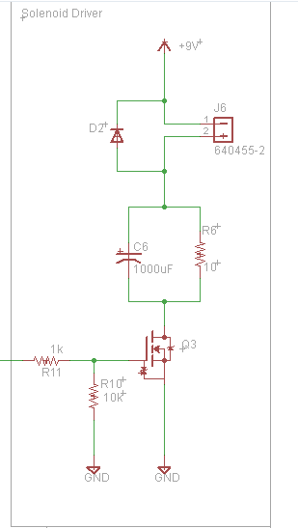
Solenoid Subsystem
MOSFET Switch
Clamp diode
Lowers voltage drop across solenoid
Reduction of current consumption from 600mA to 300mA

Slide 25
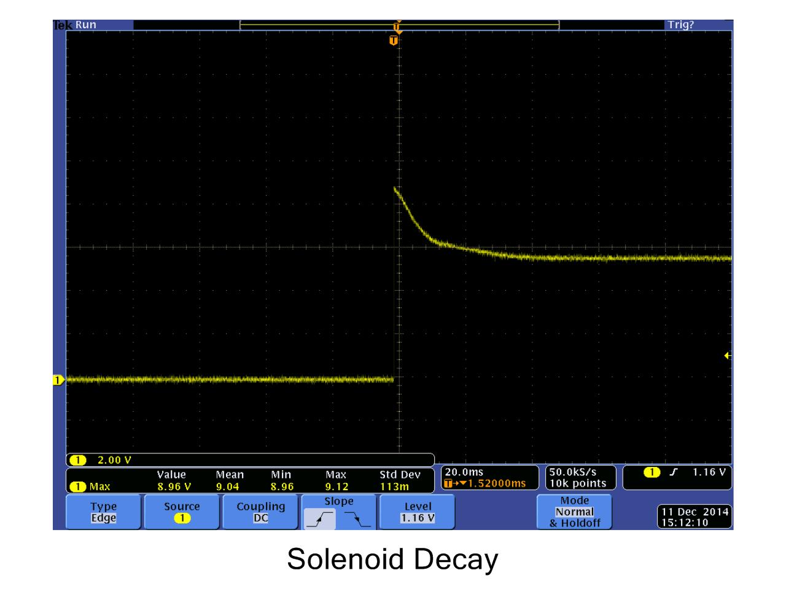

Slide 26
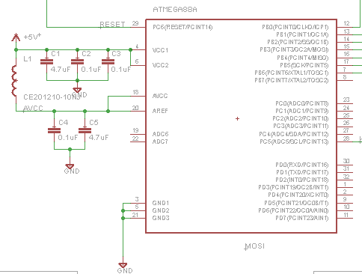
Microcontroller Subsystem
ATMega 88A
Isolated digital/ADC power supplies
Low cost and adequate memory
EEPROM too
Dev. tools available

Slide 27
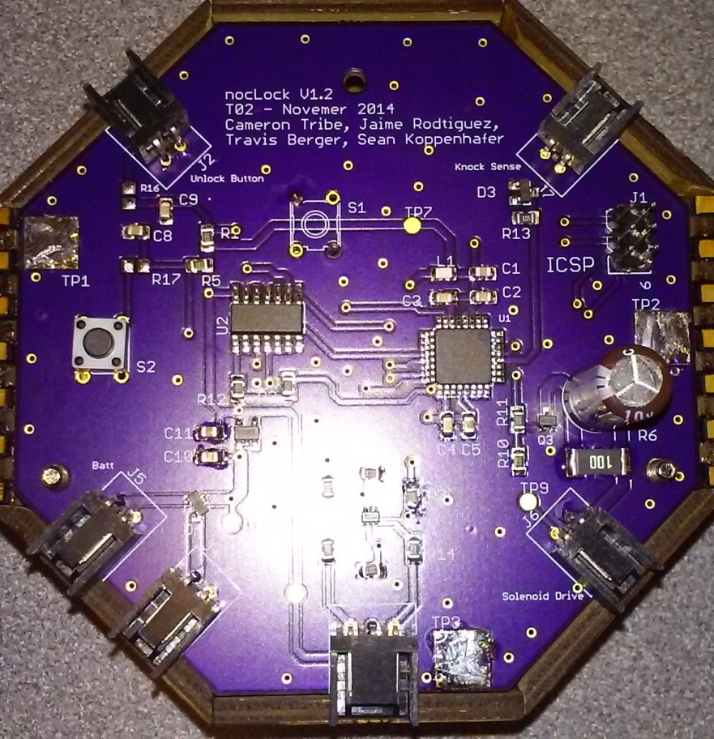
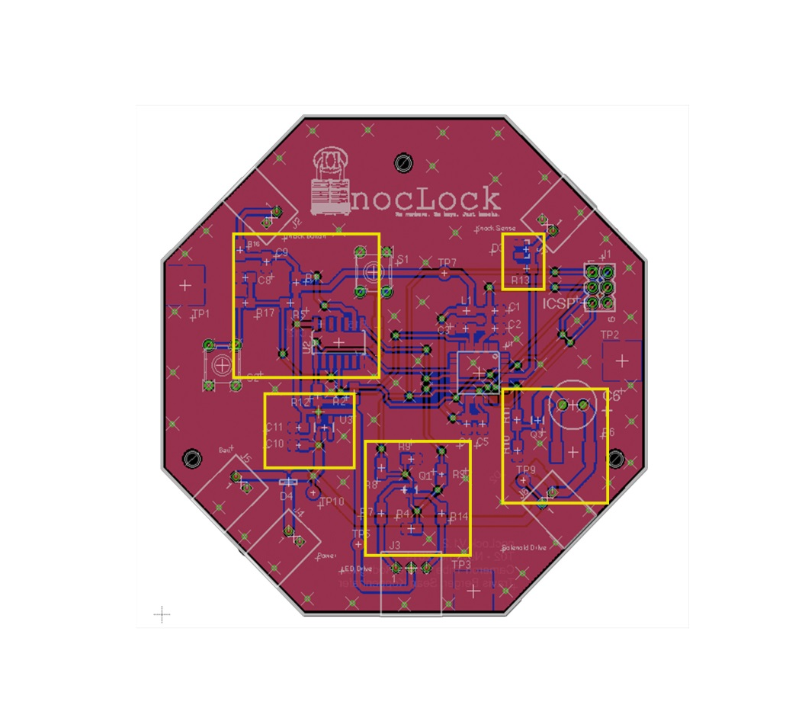
PCB Layout
Button
Inputs
Sensor
input
Power
Supply
Solenoid
LED’s

Slide 28
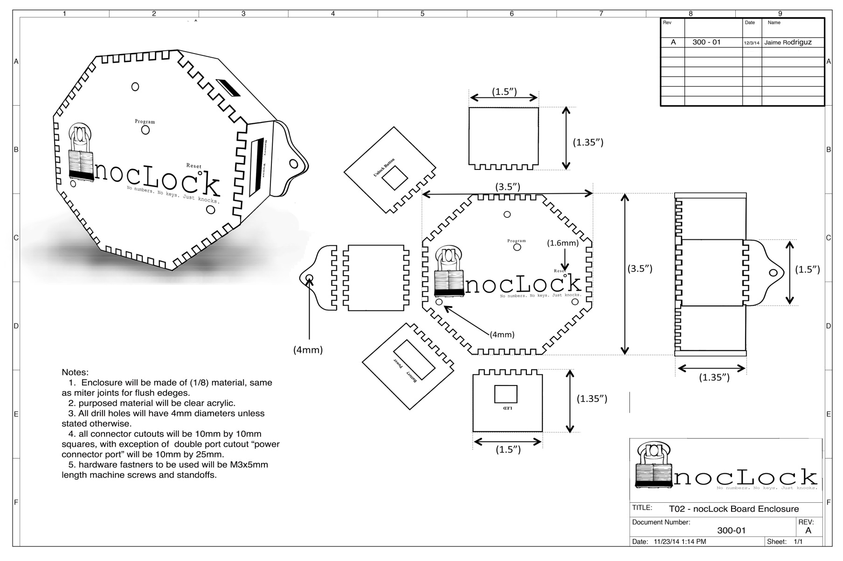
PCB Enclosure

Slide 29
Testing

Slide 30
Testing Overview
Concurrent Engineering
Verification
Characterization
Test Categories
Modular Testing
Software Testing
Integration Testing
User Testing

Slide 31
Concurrent Engineering
Verification
Testing was started during the design phase in order to verify designs
When any changes were made to a design, the new design was verified before integrating that design with anything else
Characterization
Characterized performance of key components

Slide 32
Test Categories
Modular Tests
Modular Testing was done to remove as many variables as possible in order to identify bugs/problems
Module test passes were prerequisites for larger integration tests.
S0ftware Testing
Integration Tests
Integrated modules and tested performance of entire system.
Started by using stubs to simulate integration.
User Testing
Observed beta testing of project.

Slide 33
Results
Things that worked on the board:
Solenoid Driver circuit
Power Supply
LED Driver
Things that DIDN’T work on the board
Buttons
Software for buttons
Program button
ICSP

Slide 34
Results
Things that worked in our group:
Communication
Work balance
Flexibility
Things that DIDN’T work in our group
Github for schematics
Working too soon
Communication

Slide 35
Contributions
Cameron
Travis
Sean
Jaime

Slide 36
Lessons - Cameron
Eagle CAD
Library management
PCB Layout
Schematic Drawing
Simple CAD drawings
EPL equipment
Microcontroller interfacing
Project management

